Slide 1
Air Quality Analysis: Relationship Between Readings From Short-term and Long-term Monitors
Lingjie Wang
Advisors: J. S. Marron, Yufeng Liu
Client: Elizabeth Mannshardt
April 18, 2017

Slide 2
Content
Introduction
Data Description
Analysis On Hourly Concentration
Analysis On Daily AQI
Conclusion

Slide 3
Introduction
Official Air Quality Index (AQI) at Chicago:
1. Measure two pollutants (PM2.5 & Ozone) at several sites;
2. Calculate daily 24-hour (PM2.5) / peak 8-hour (Ozone) average;
2. Calculate two corresponding daily AQI for PM2.5 and Ozone ;
3. Larger AQI is reported as “general AQI”.
Project Objective: Study the relationship between two monitors’ measurements:
FRM: Federal Reference Monitor (Official); 1-Hour readings.
VG: Village Green Bench Monitor; 1-Minute readings.
Analysis on:
1. Hourly concentration;
2. Daily AQI.
Notes:
Intending to provide information in shorter increments, Environmental Protection Agency (EPA) uses Village Green (VG) benches’ monitors to detect 1-minute concentration of PM2.5 and Ozone. To evaluate the performance of such VG monitors

Slide 4
Data Description
PM2.5:
1. Time period: 2016-03-13 00:00:00 to 2016-08-31 21:00:00 Chicago Local Time (UTC– 5 hours); 3964 valid hours total.
2. Number of monitor sites:
FRM monitors: 9 sites
VG monitor: 1 site
3. Sample size:
FRM readings: 25,126 hourly PM2.5 concentrations.
VG readings: 189,415 1-minute concentrations.

Slide 5
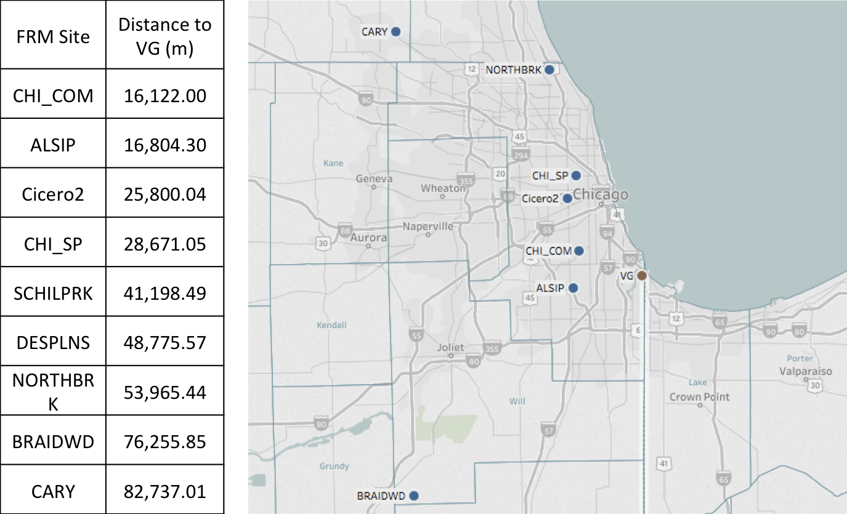
Table: FRM sites detecting PM2.5 in Chicago and their distances to the VG site. The sites are ordered by distances from near to far.
Figure: Locations of 9 FRM sites detecting PM2.5 and the VG site in Chicago. The VG site is represented in color brown.

Slide 6
Data Description
Ozone:
1. Time period: 2016-03-13 00:00:00 to 2016-08-31 13:00:00 Chicago Local Time (UTC– 5 hours); 4096 valid hours total.
2. Number of Sites:
FRM monitors: 14 sites
VG monitor: 1 site
3. Sample size:
FRM readings: 53,591 hourly Ozone concentrations.
VG readings: 204,759 1-minute concentrations.

Slide 7
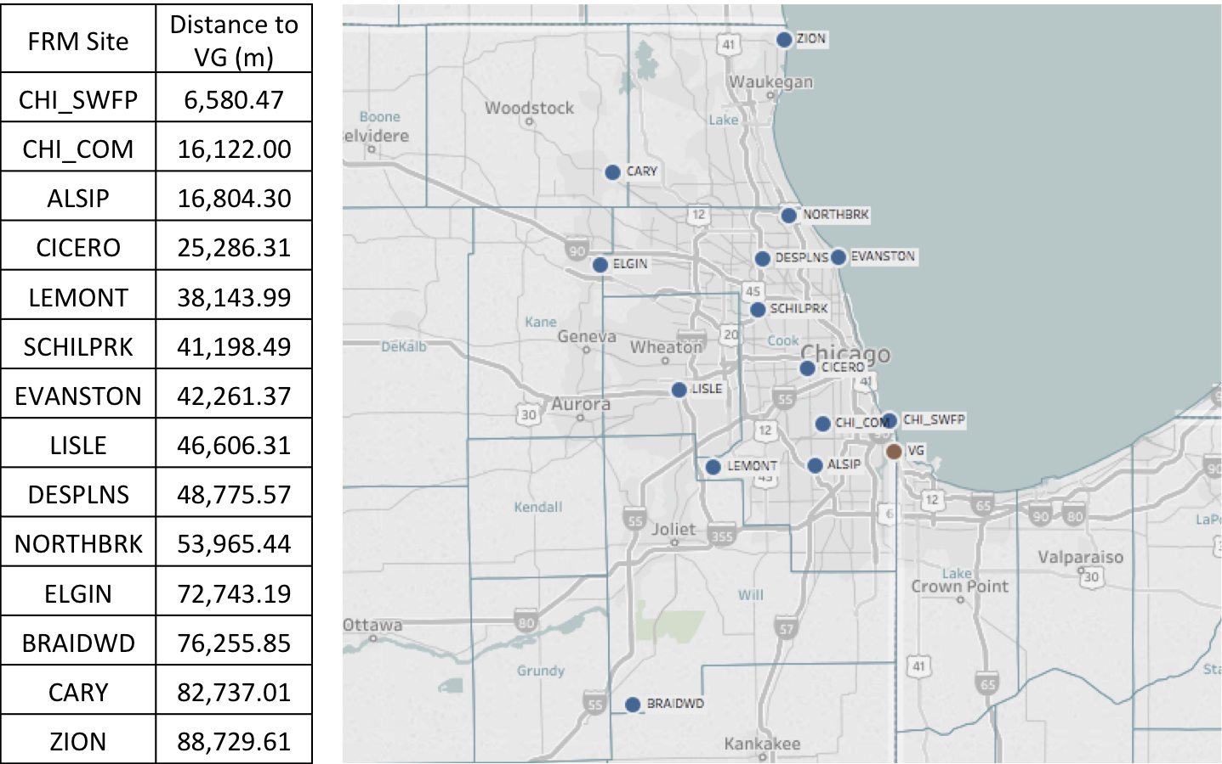
Table: FRM sites detecting Ozone in Chicago and their distances to the VG site. The sites are ordered by such distances from near to far.
Figure: Locations of 14 FRM sites detecting Ozone and the VG site in Chicago. The VG site is represented in color brown.

Slide 8
Analysis on Hourly Concentration
Data: hourly reading of PM2.5 and Ozone concentration from FRM monitors, and hourly average rolled up from VG bench 1-minute data based on the following equation:
e.g.
Note: Removed two sites from analysis (DESPLNS & SCHILPRK): 99% data missing.
Analyses conducted on FRM and VG data:
1. Calculated correlation between data from each FRM site and the VG site, with corresponding hypothesis testing;
2. Studied relationship between distance (between two sites) and correlation (between data from these two sites);
3. Conducted test of equality on means of data from each FRM site and the VG site.
Notes:
!!!!!!!!!! Hypothesis testing method

Slide 9
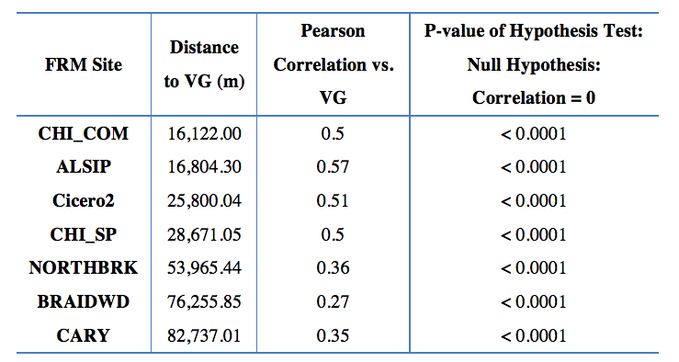
PM2.5
1. Correlations related:
Findings:
Highest correlation: second closest site;
Trend: Correlation decrease with distance.
Notes:
Distance, Pearson correlation and a 95% confidence interval between (data from) the VG site and each of 7 FRM sites. The FRM sites are ordered by distance to the VG site.

Slide 10
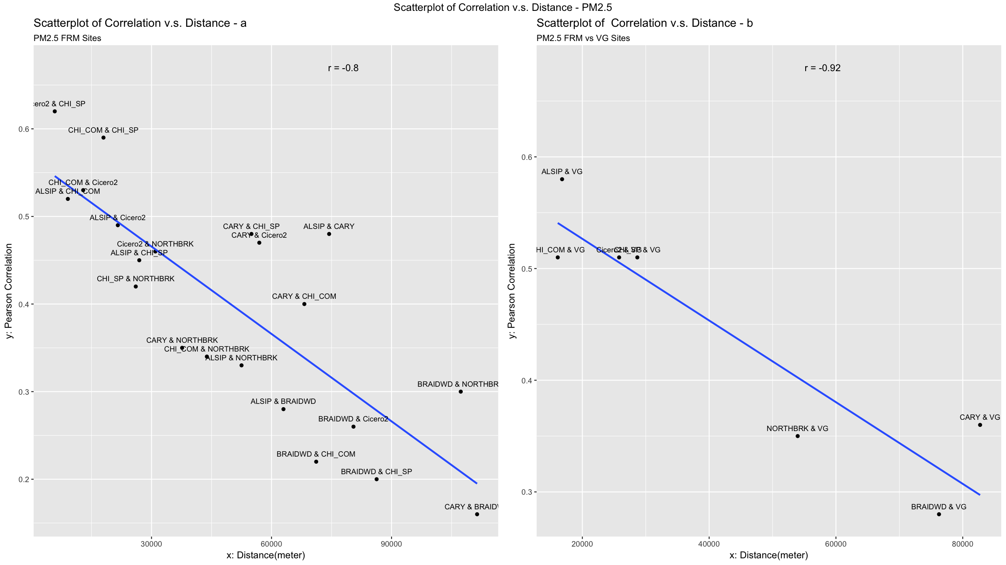
PM2.5
2. Relationship between distance and correlation:
Finding:
Negative linear relationship between correlation and distance between FRM and the VG site;
Such relationship is consistent with that between pairs among only FRM sites.
Notes:
Scatterplots of distances between a pair of sites against the corresponding correlation between data from this pair of sites. Scatterplot ‘a’ includes pairs among only FRM sites, and scatterplot ‘b’ includes only pairs consisting of the VG site and one FRM site.

Slide 11
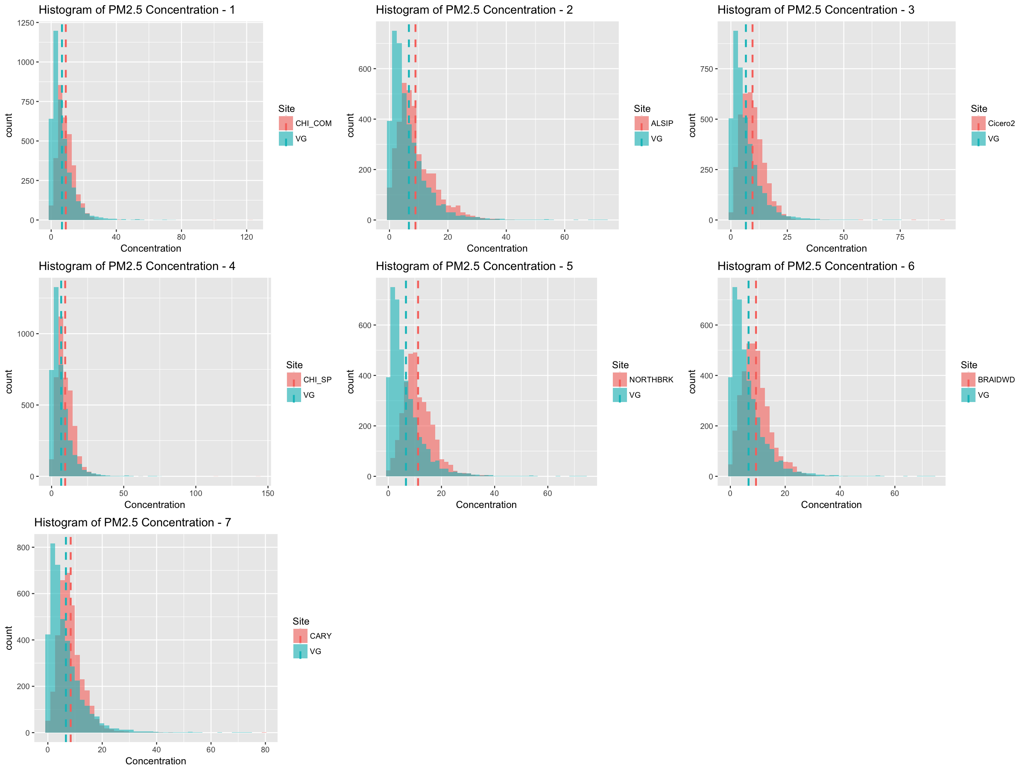
PM2.5
3. Test of Equality:
Histogram indicating skewness -> suggesting data transformation.

Slide 12
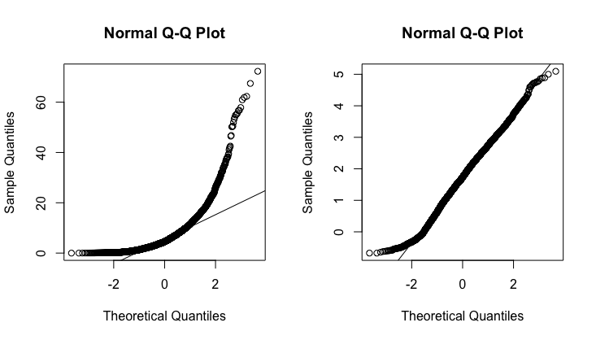
PM2.5
Box-Cox Transformation method applied: skewness reduced
e.g. Q-Q plots of VG data before and after Box-Cox transformation (lambda = 0.08).
Tests: Wilcoxon signed-rank test on raw data, and paired T test on data after Box-Cox transformation.
Results: For each pair of one FRM site and the VG site, p-values of all tests < 0.0001.
Conclusion: Mean of data from VG site is significantly different from that of any FRM site.
Notes:
The two plots show that Box-Cox transformation reduces skewness effectively.

Slide 13
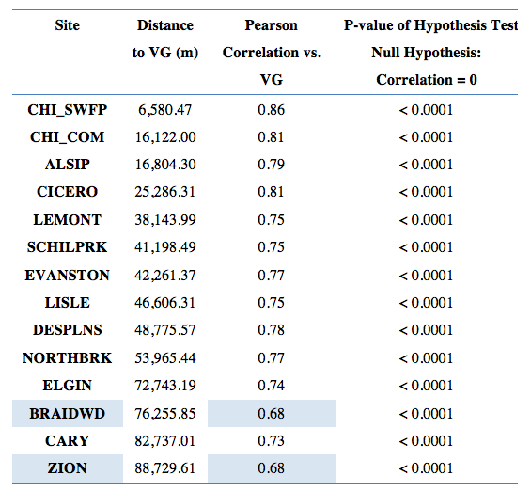
Ozone
1. Correlations related:
Findings compared with PM2.5 case:
Higher correlations: least correlation is 0.68;
Relationship between correlation and distance less clear.

Slide 14
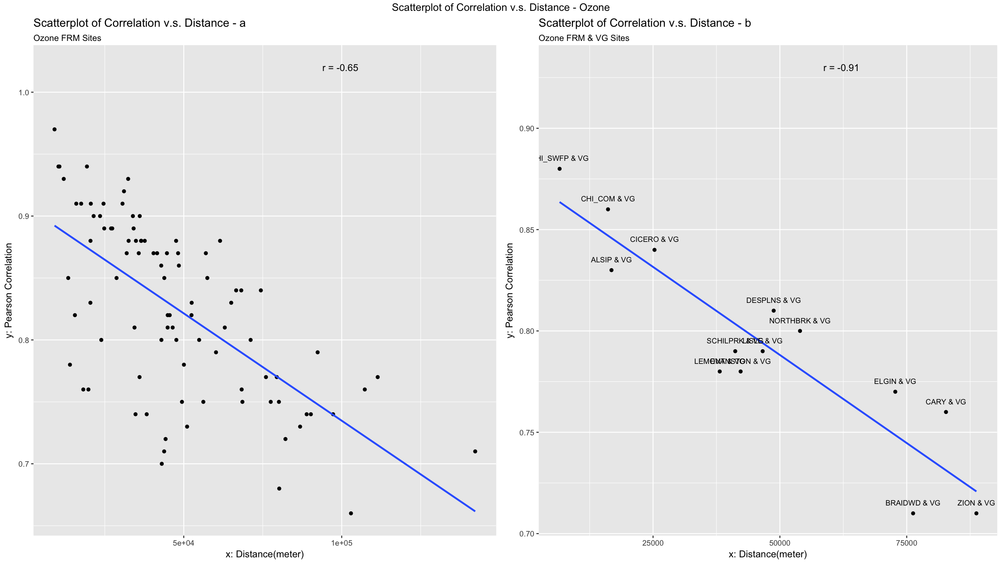
Ozone
2. Relationship between distance and correlation:
Finding:
Negative linear relationship between correlation and distance between FRM and the VG site;
Such relationship is consistent with that between pairs among only FRM sites.

Slide 15
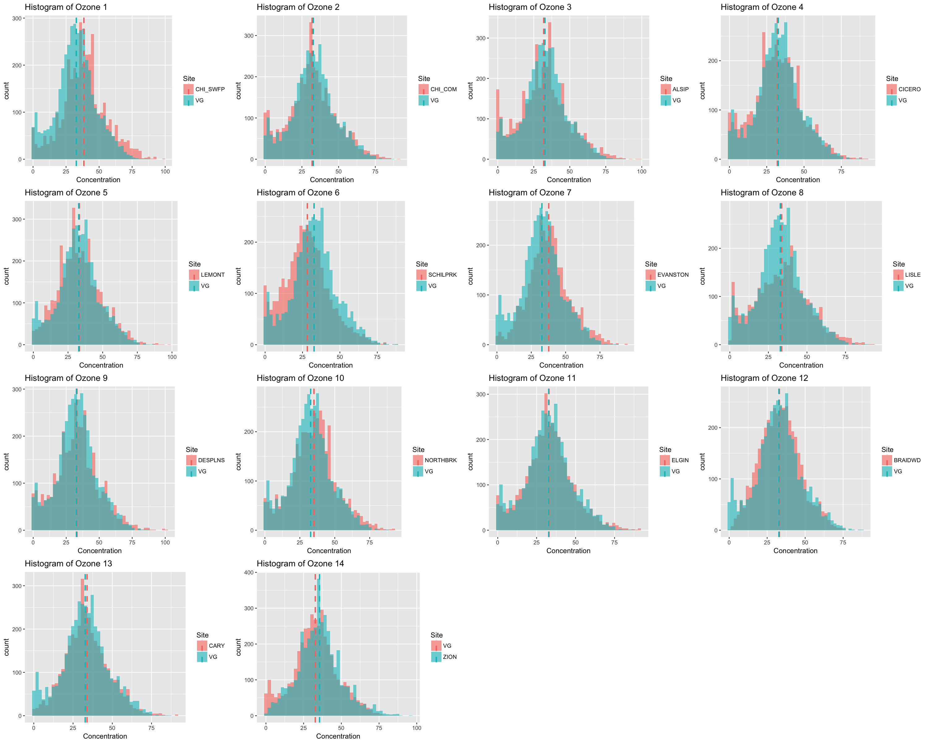
Ozone
3. Test of Equality:
Less skewed than PM2.5 data

Slide 16
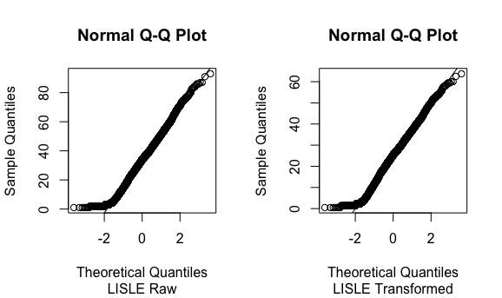
Ozone
Box-Cox Transformation method applied:
Optimal lambda values close to 1, suggesting distributions close to normal distribution; little changes after transformation.
e.g. Q-Q plots of site LISEL data before and after transformation (lambda = 0.9 ).
Tests:
1. T test on raw data: 7 nearest sites have p-values <0.0001; 4 sites have p-values > 0.01, and 3 far from lake.
2. T test on transformed data: similar; p-values decrease except one.
3. Wilcoxon signed-rank test: discrepancy exists in some; test might be less appropriate since distribution is not that non-normal.
Notes:
Raw:LISLE:0.0418; DESPLNS:0.1212; ELGIN:0.0143; BRAIDWD: 0.0768
Transformed: LISLE:0.0104; DESPLNS:0.0545; ELGIN:0.0238; BRAIDWD: 0.0141

Slide 17
Analysis on Daily AQI
Data:
1. Daily PM2.5 AQI and Ozone AQI calculated based on daily average of hourly concentration: Ozone: peak 8-hour running average; PM2.5 AQI: 24-hour average.
2. 75% completeness rule
Analyses conducted: same as in the case of hourly concentration
1. Calculated correlation between data from each FRM site and the VG site, with corresponding hypothesis testing;
2. Studied relationship between distance (between two sites) and correlation (between data from these two sites);
3. Conducted test of equality on means of data from each FRM site and the VG site.
Notes:
!!!!!!!!!! Hypothesis testing method

Slide 18
PM2.5
Similar results compared with hourly PM2.5 concentration analyses:
1. Slightly larger correlations between FRM AQI and VG AQI;
2. Negative linear relationship between distance and correlation still holds;
3. Sample distributions are right-skewed, transformation applied:
Results: the p-values of tests on PM2.5 AQI are all less than 0.0001, implying that the mean of hourly PM2.5 AQI from FRM sites are significantly different from that of the VG site.
Notes:
1. Least is 0.61

Slide 19
Ozone
Compared with hourly Ozone concentration analyses:
Similar:
1. Slightly larger correlations between FRM AQI and VG AQI;
2. Negative linear relationship between distance and correlation still holds.
Different:
Sample distributions are right-skewed;
Results:
Wilcoxon signed-rank test: 2 sites with large p-values (0.4297, 0.9687); CARY is one of the 4 sites in the case of hourly Ozone concentration;
Paired T test on transformed data: same two sites with large p-values with (0.4896, 0.3678)

Slide 20
Largest Daily AQI
1. Counts and percentage of days reported as “general AQI” (largest AQI)
FRM sites:
PM2.5: NORTHBRK accounts for the largest percentage of 39% (64 days), while the least is CHI_COM accounting for 7% (11 days);
Ozone: CHI_SWFP accounts for the largest percentage of 28% (47 days), while SCHILPRK has 0 days in total.
General: PM2.5 AQI accounts for 63.19% (103 days) and Ozone AQI accounts for 36.81% (60 days).
VG site:
PM2.5 AQI accounts for 74.12% (126 days), and Ozone AQI accounts for 25.88% (44 days).

Slide 21
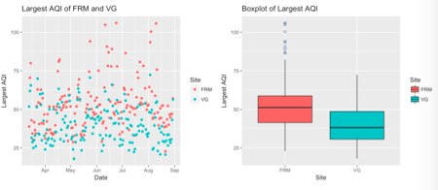
Largest Daily AQI
2. Relationship between largest AQI of FRM sites and largest AQI of VG site
Correlation = 0.75;
FRM AQI is generally larger than VG AQI.
P-values of Wilcoxon signed-rank test/paired T test on transformed data:
Both < 0.0001, indicating significant difference

Slide 22
Conclusion
For hourly concentration and daily AQI:
1. the corresponding correlation between the data from VG site and FRM monitors tends to decrease with the distance between them.
2. Also, for Ozone, the data from FRM monitors has generally higher correlations with data from VG monitor than PM2.5.
For general (largest) AQI:
The result from FRM monitors is larger than the result from the VG monitor in most days from March, 2016 to September, 2016.

